Slide 1
Target Audiences
Interactive Media
Unit 1

Slide 2
Starter – 5 Minutes
Answer the following on your whiteboards:
Write down the different factors that are considered when designing an interactive media product.
Notes:
How presentation will benefit audience: Adult learners are more interested in a subject if they know how or why it is important to them.
Presenter’s level of expertise in the subject: Briefly state your credentials in this area, or explain why participants should listen to you.

Slide 3
Learning Outcomes
Understand the term “target audience” and what that means for an interactive media product.
Describe the different factors that are considered for the target audience.
Explain how products are designed and targeted differently depending on the target audience.

Slide 4

Target Audience
A target audience is the group of people that a product is intended for.
This doesn’t however mean that the product can’t or shouldn’t be used by a different audience, however it may have less impact.
For example, hair grips will have an intended audience of those with longer hair.
Someone with short hair however may find little use for it.

Slide 5
Categories of Target Audience
An audience can be broken up into the following categories:
Gender
Age
Ethnicity
Income
Lifestyle
Location
Accessibility
And more.

Slide 6
Disclaimer
The information regarding each category of target audience is generalised.
Not all people of the same gender, age or income will share the exact same interests.
Be careful when writing about this content, always use links to back up what you say.

Slide 7
Portfolio Setup
Add the following headings to your portfolio:
Target Audience (Heading 1)
Gender (Heading 2)
Age (Heading 2)
Income (Heading 2)
Lifestyle (Heading 2)
Location (Heading 2)
Accessibility (Heading 2)

Slide 8
Gender, Age
When designing a product, considerations are made for the gender of the target audience.
Typically, a product is directly intended to be a male product, a female product or one for no specific gender.
The age of an audience could either be a specific age or covering a range, such as 11-16.

Slide 9
Task 1 – Gender and Age
Discuss the following questions with your neighbours, then add your answers to your portfolios under the correct headings:
What colours would you expect to see targeted towards each males and females?
How would you plan a product differently between adults and teenagers?
What would appeal to an audience regardless of gender?
What about regardless of gender and age?

Slide 10
Ethnicity, Income
Someone’s ethnicity is a group that they belong to because of their background ancestry or the culture they associate with.
This is a topic of much scrutiny in the public eye; there is a difference between targeting a product at an ethnic group and profiling a specific group based on their ethnicity.
Income is how much money somebody has from their wages which they may be able to spend on things.

Slide 11
Task 2 – Ethnicity and Income
Discuss the following questions with your neighbours, then fill in your answers in your portfolio under the correct headings:
How does someone’s income effect their ability to buy a product?
Can we target a particular ethnic group with a product?
How would the income of the target audience effect the planning of a product?

Slide 12
Location, Accessibility
Location refers to the place where somebody lives or where they spend most of their time.
Accessibility is about making sure a product is planned to be available to as many people as possible

Slide 13
Lifestyle
A person’s lifestyle refers to the activities that they do on a day-to-day basis or for recreation.
For example, a person who likes to play Football and Tennis in their free time would consider sport to be part of their lifestyle.
Someone who likes to read books and play video games in their free time might consider reading and gaming part of their lifestyle.

Slide 14
Task 3 – Location and Accessibility
Discuss the following questions with your neighbours, then fill in your answers in your portfolio under the correct heading:
What kind of disabilities may impair someone’s ability to access a product?
How would the wants of a person living in a city differ from someone living in a town or the countryside?
Is there a difference between the things people like in the North and the South of the UK?

Slide 15
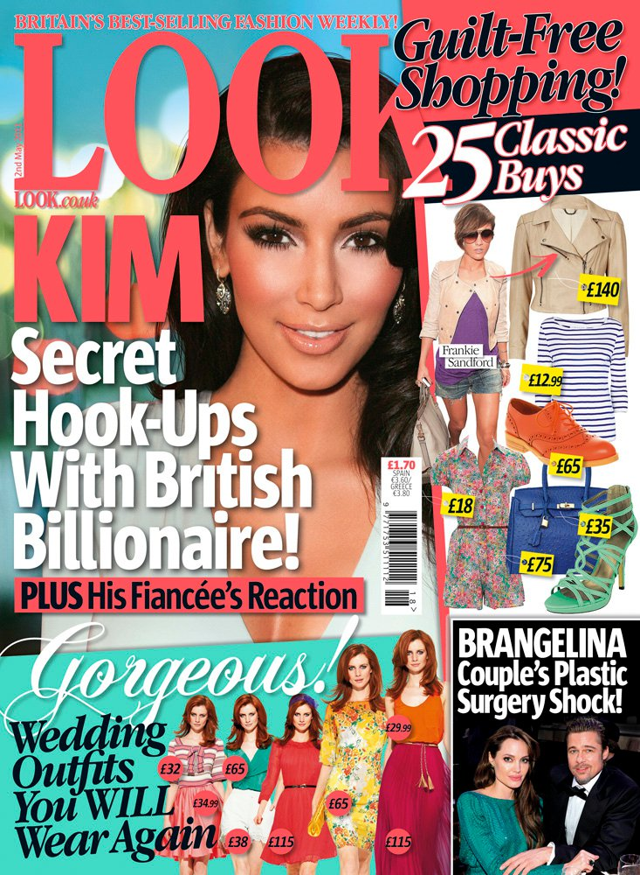
Magazine Case Study 1
Look Magazine
Gender – Female
Age – 20-40
Lifestyle – Like celebrity culture, shopping for clothes
Ethnicity – Any ethnicity
Income – Low and Middle (Issue costs £1.70)
Location – All of UK

Slide 16

Magazine Case Study 2
Simpsons Comics
Gender – Either
Age – 8-16
Lifestyle – Like cartoons, comedy
Ethnicity – Any ethnicity
Income – High and Middle(Issue costs $4.99)
Location – English-Speaking Countries

Slide 17
Task 4 – Information on Factors
For each of the factors mentioned, explain the following in your portfolios, under the correct heading:
How might this factor affect the development of a product? E.g. what features might change? What colours? Etc.
Explain the differences in that factor, e.g. what are the different age groups and how is a product different for them?
How would a developer need to be careful when considering these factors?
Gender
Age
Lifestyle
Accessibility
Income
Location

Slide 18

Extension 1 – Game Case Study
Select a game and include a screenshot in your portfolio.
Explain the target audience for the game for each of the factors below:
Gender –
Age –
Lifestyle –
Accessibility –
Income –
Location –

Slide 19
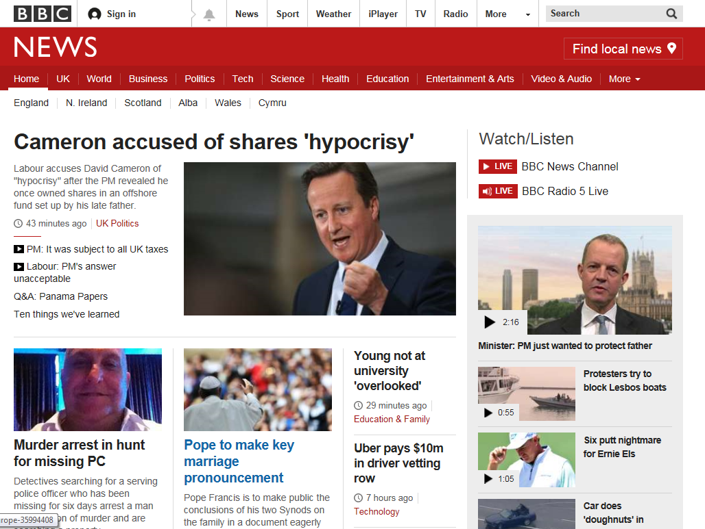
Extension 2 – Website Case Study
Select a website and include a screenshot in your portfolio.
Explain the target audience for the game for each of the factors below:
Gender –
Age –
Lifestyle –
Accessibility –
Income –
Location –

